Slide 1
Aramco Upstream Solutions Technathon 2019 Robotics challenge Design of a UAV based sensor deployment logistics system
Bodong Li
Robotics and IoT Technology Leader, EXPEC Advance Research Center Saudi Aramco

Slide 2
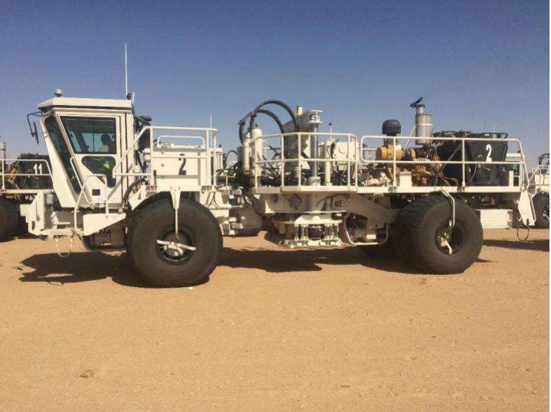
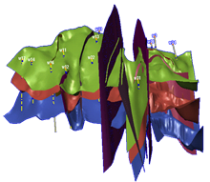
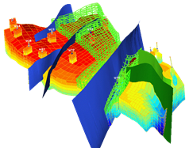
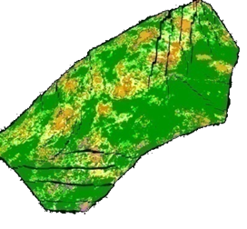
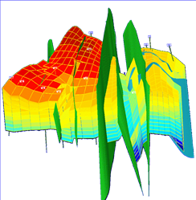
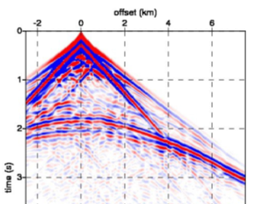
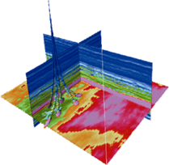
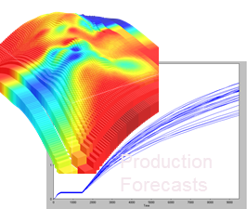
Background: Exploration and Field Development Chain
Seismic
acquisition
Structural
model
Stratigraphic
model
Geological
model
Reservoir
model
Seismic
data
Seismic
model
History
matching

Slide 3
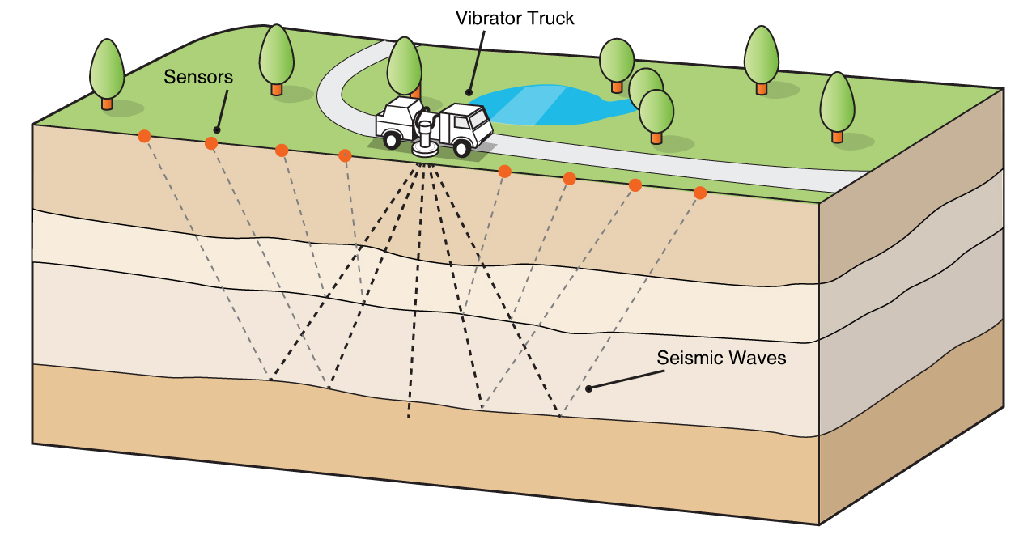
Background: Seismic Acquisition
midpoint

Slide 4
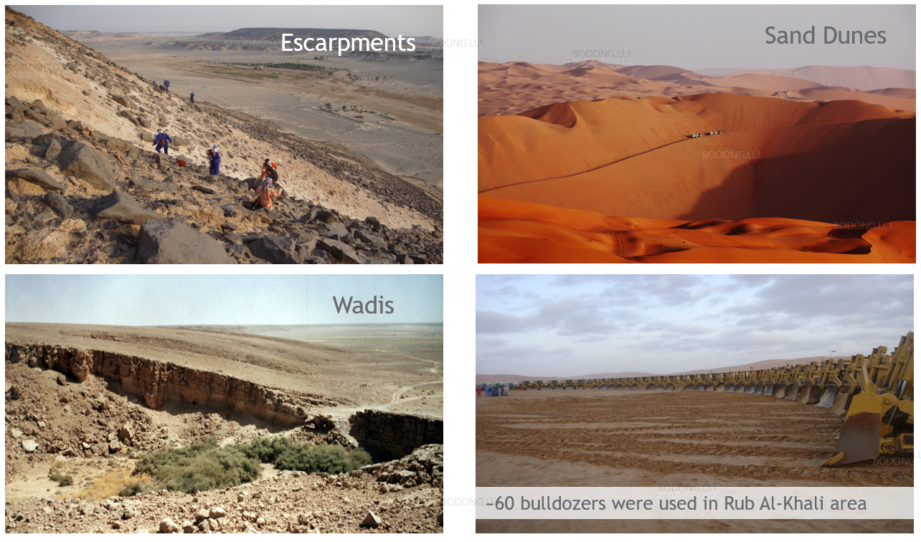
Challenges: Terrain and Operational Challenges

Slide 5
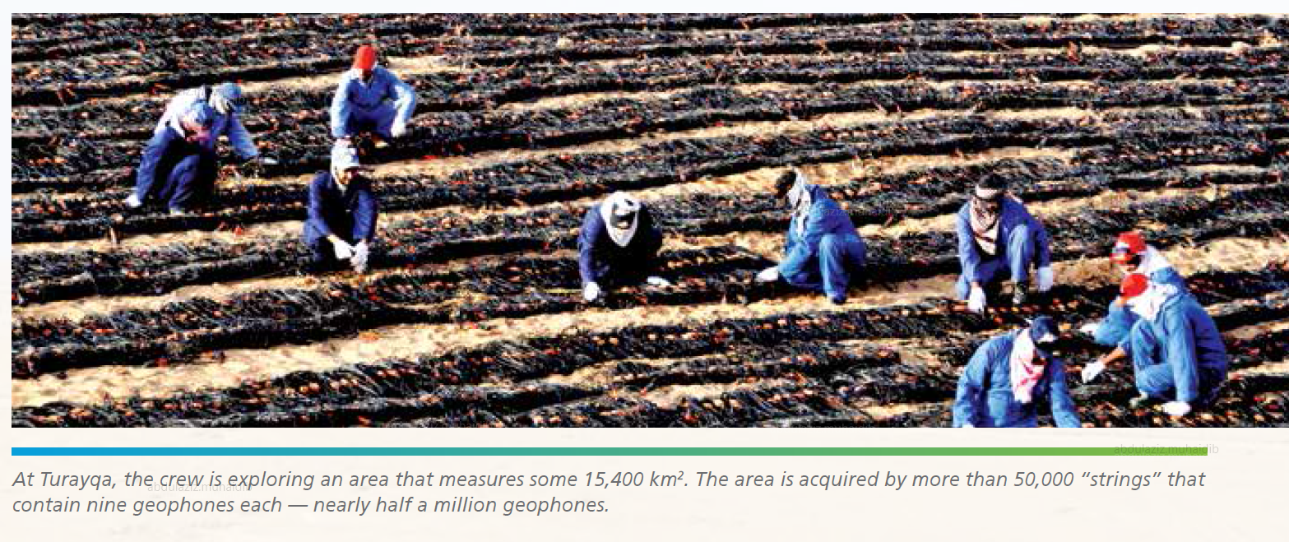
Challenges: Seismic Sensor Deployment and Retrieval
Seismic operations require continuously moving 100s of thousands of geophones that require regular maintenance
The operations entail high cost, long operation time, and safety exposure
Arabian Sun, June 2017

Slide 6
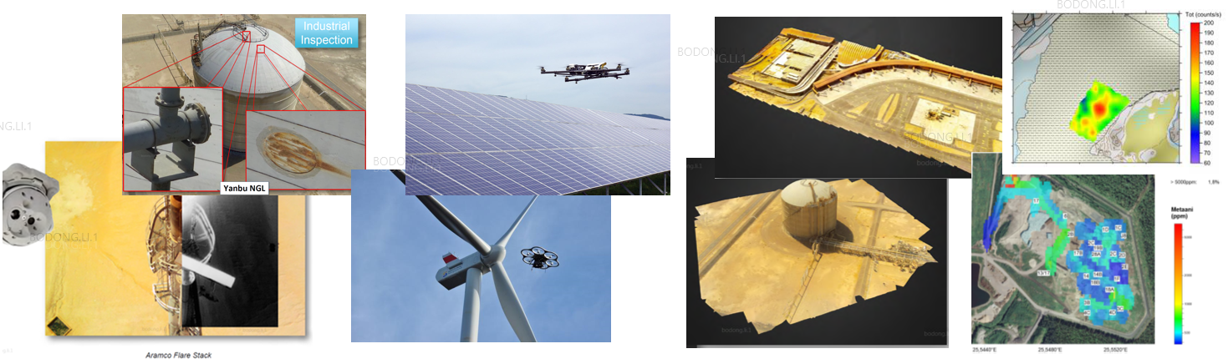
Industrial UAV Applications: In-air Inspection/Sensing
Asset/Construction Inspection
Geophysical
3D Mapping

Slide 7
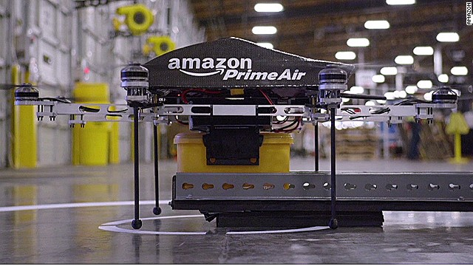
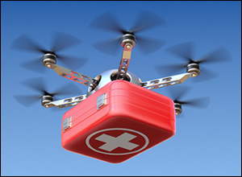
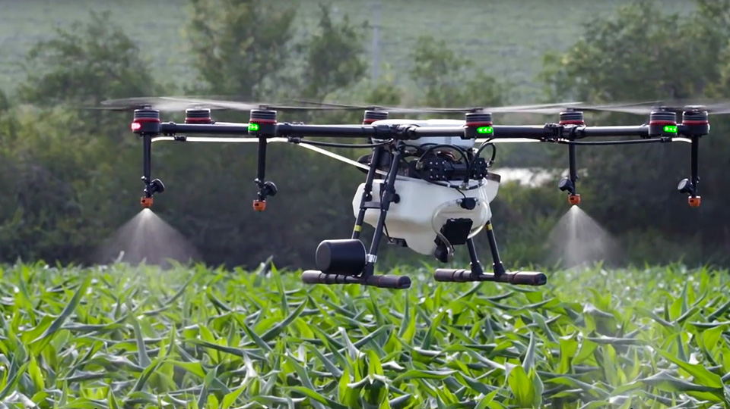
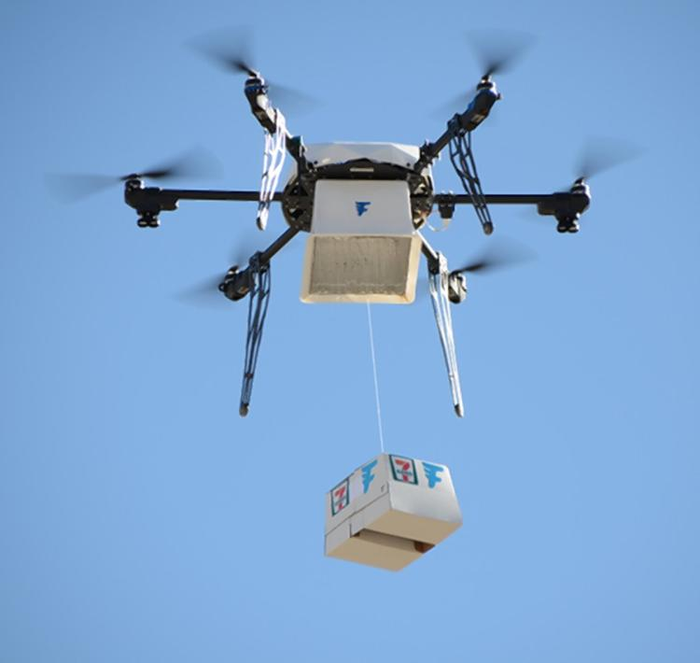
Industrial UAV Applications: Carrying Payload as a Service
Logistics
Emergency
Agriculture
Remote Delivery

Slide 8
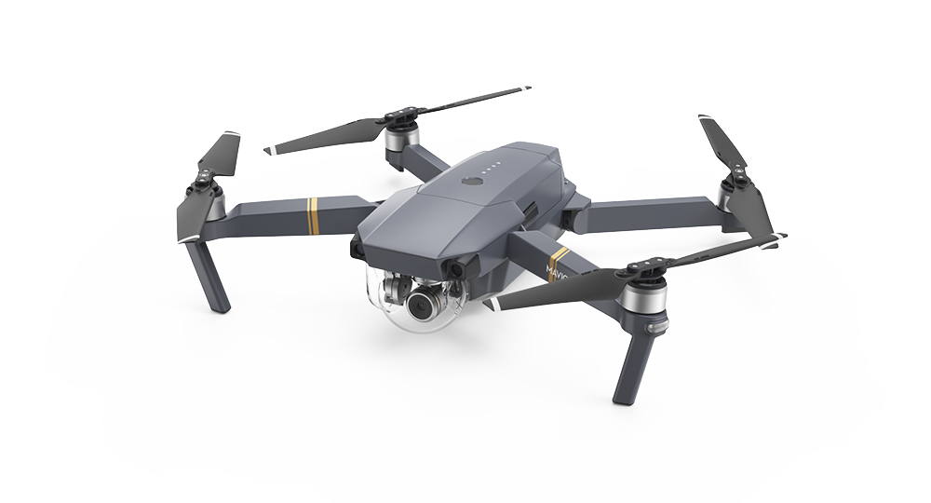
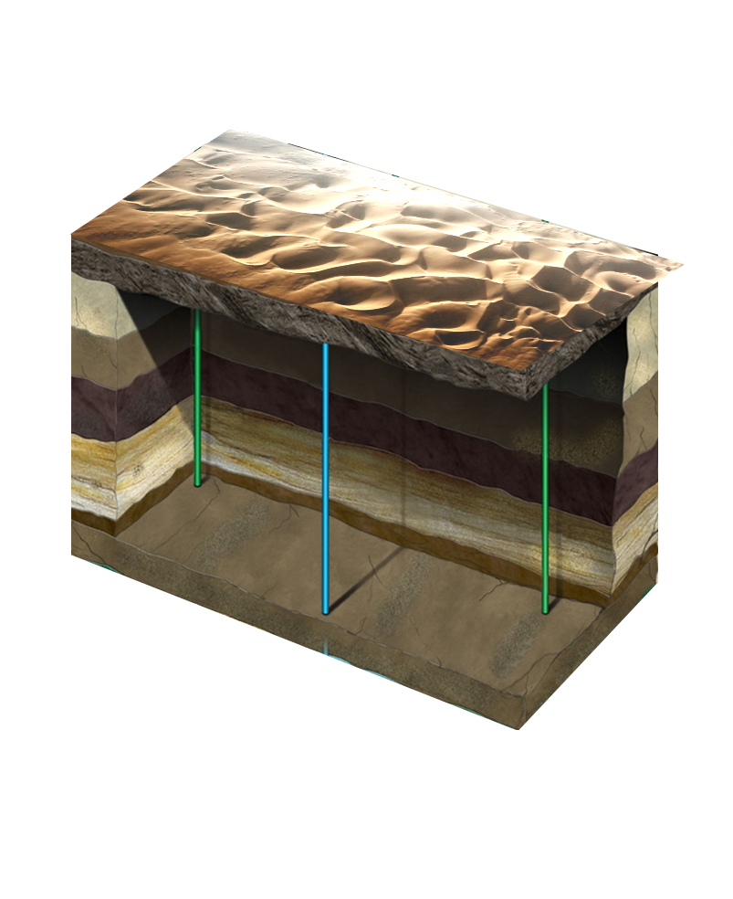
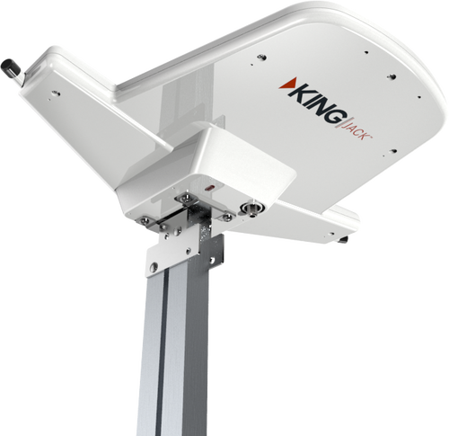
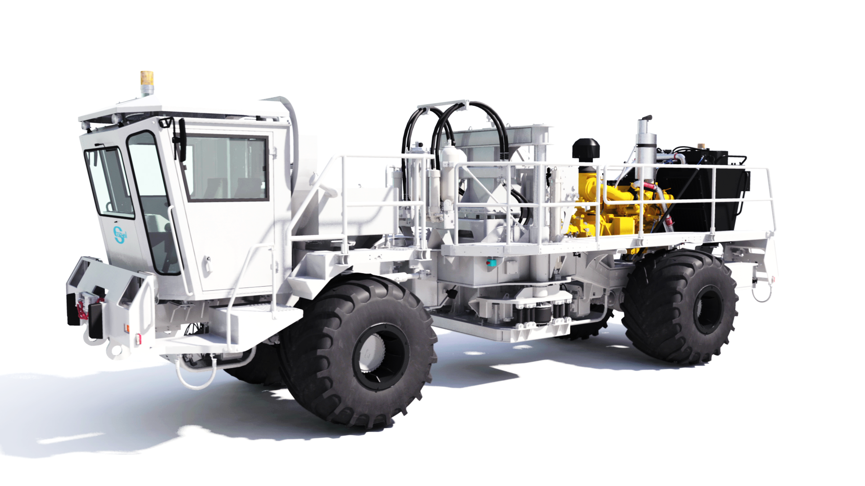
Motivation – Using UAV for Seismic Acquisition
Use of UAVs equipped with geophones for seismic acquisition
Swarm of UAVs work collaboratively to conduct the task for seismic acquisition

Slide 9
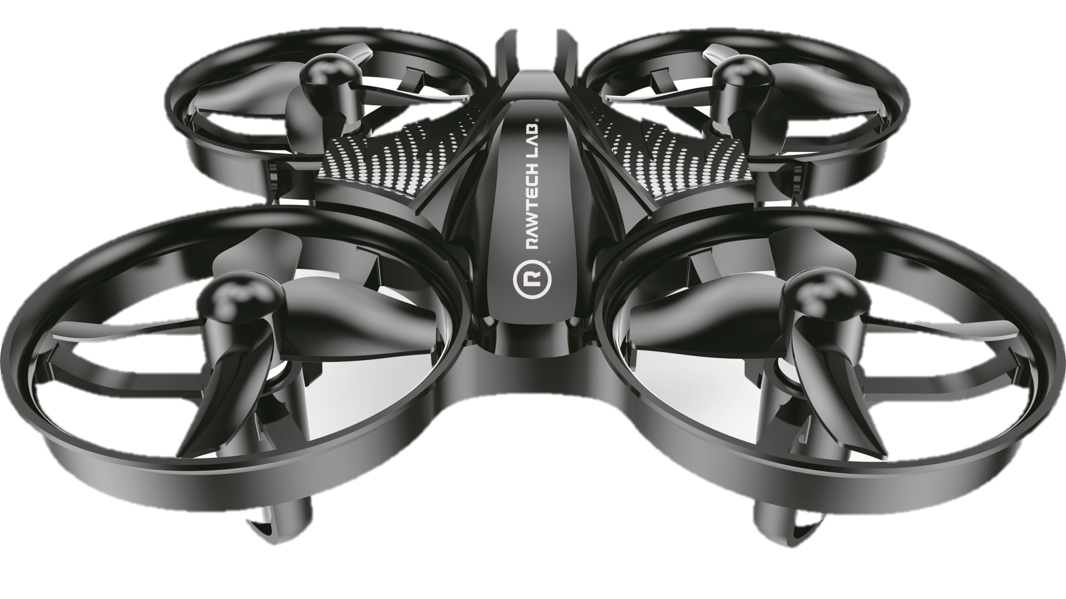
Details of the challenge
(10000,2000)
In ROS Gazebo simulator program swarm of 5 drones to do typical land seismic acquisition in a most efficient way
Seismic grid: 41 lines with inline offset 50m and crossline offset 50m (X-range: 0-10000,Y-range:0-2000)
Source is moving at a speed of 5kph along straight line (Y = 50)
Source regime:
18sec sweep, 6 sec listening time
Midpoint of interest range:
X-axis: 4500-6500
Y-axis: 300-900
Y axis
(0,0)
X axis

Slide 10
Virtual drone parameters
Charging/data uploading base is located at (5000, 1000)
Cruise speed: 50 kph
Battery replacement time: 10min
Charging base can serve only 2 drones at a time
Battery lifespan for mobility: 30 min
Battery lifespan for measurement (same battery): 10h
Signal can be recorded only when drone is fully landed on recording location and source is active
Simulated acquisition time: 10 hours

Slide 11

Evaluation of the performance
A presentation with the solution
Demonstrate largest number of midpoints recorded
Programmed swarm of 5 virtual drones
Challenge target is to complete largest number of the recording locations
Demonstrate scalability of the solution

Slide 12

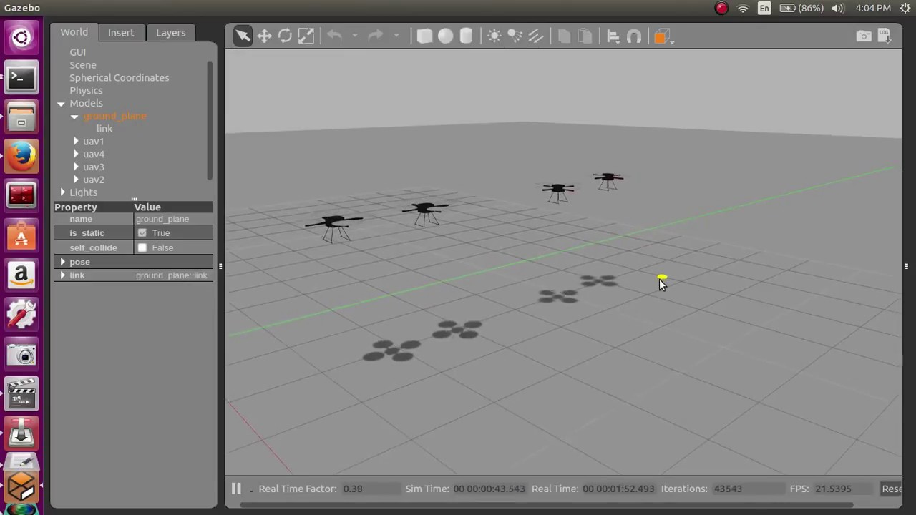
Supplies
Each team will have access to Hi-End Workstation with
Hardware:
CPU: Xeon Gold 6142 32-core
RAM: 4x32Gb DDR4
GPU: Nvidia Quadro P5000 16Gb VRAM
Software:
Ubuntu 18.10
ROS Melodic Morenia
Gazebo installation is packaged with ROS Melodic Morenia
Adopted from: Arjun S Kumar | Simulation of UAV / Quadcopter Swarm in ROS Gazebo

Slide 13
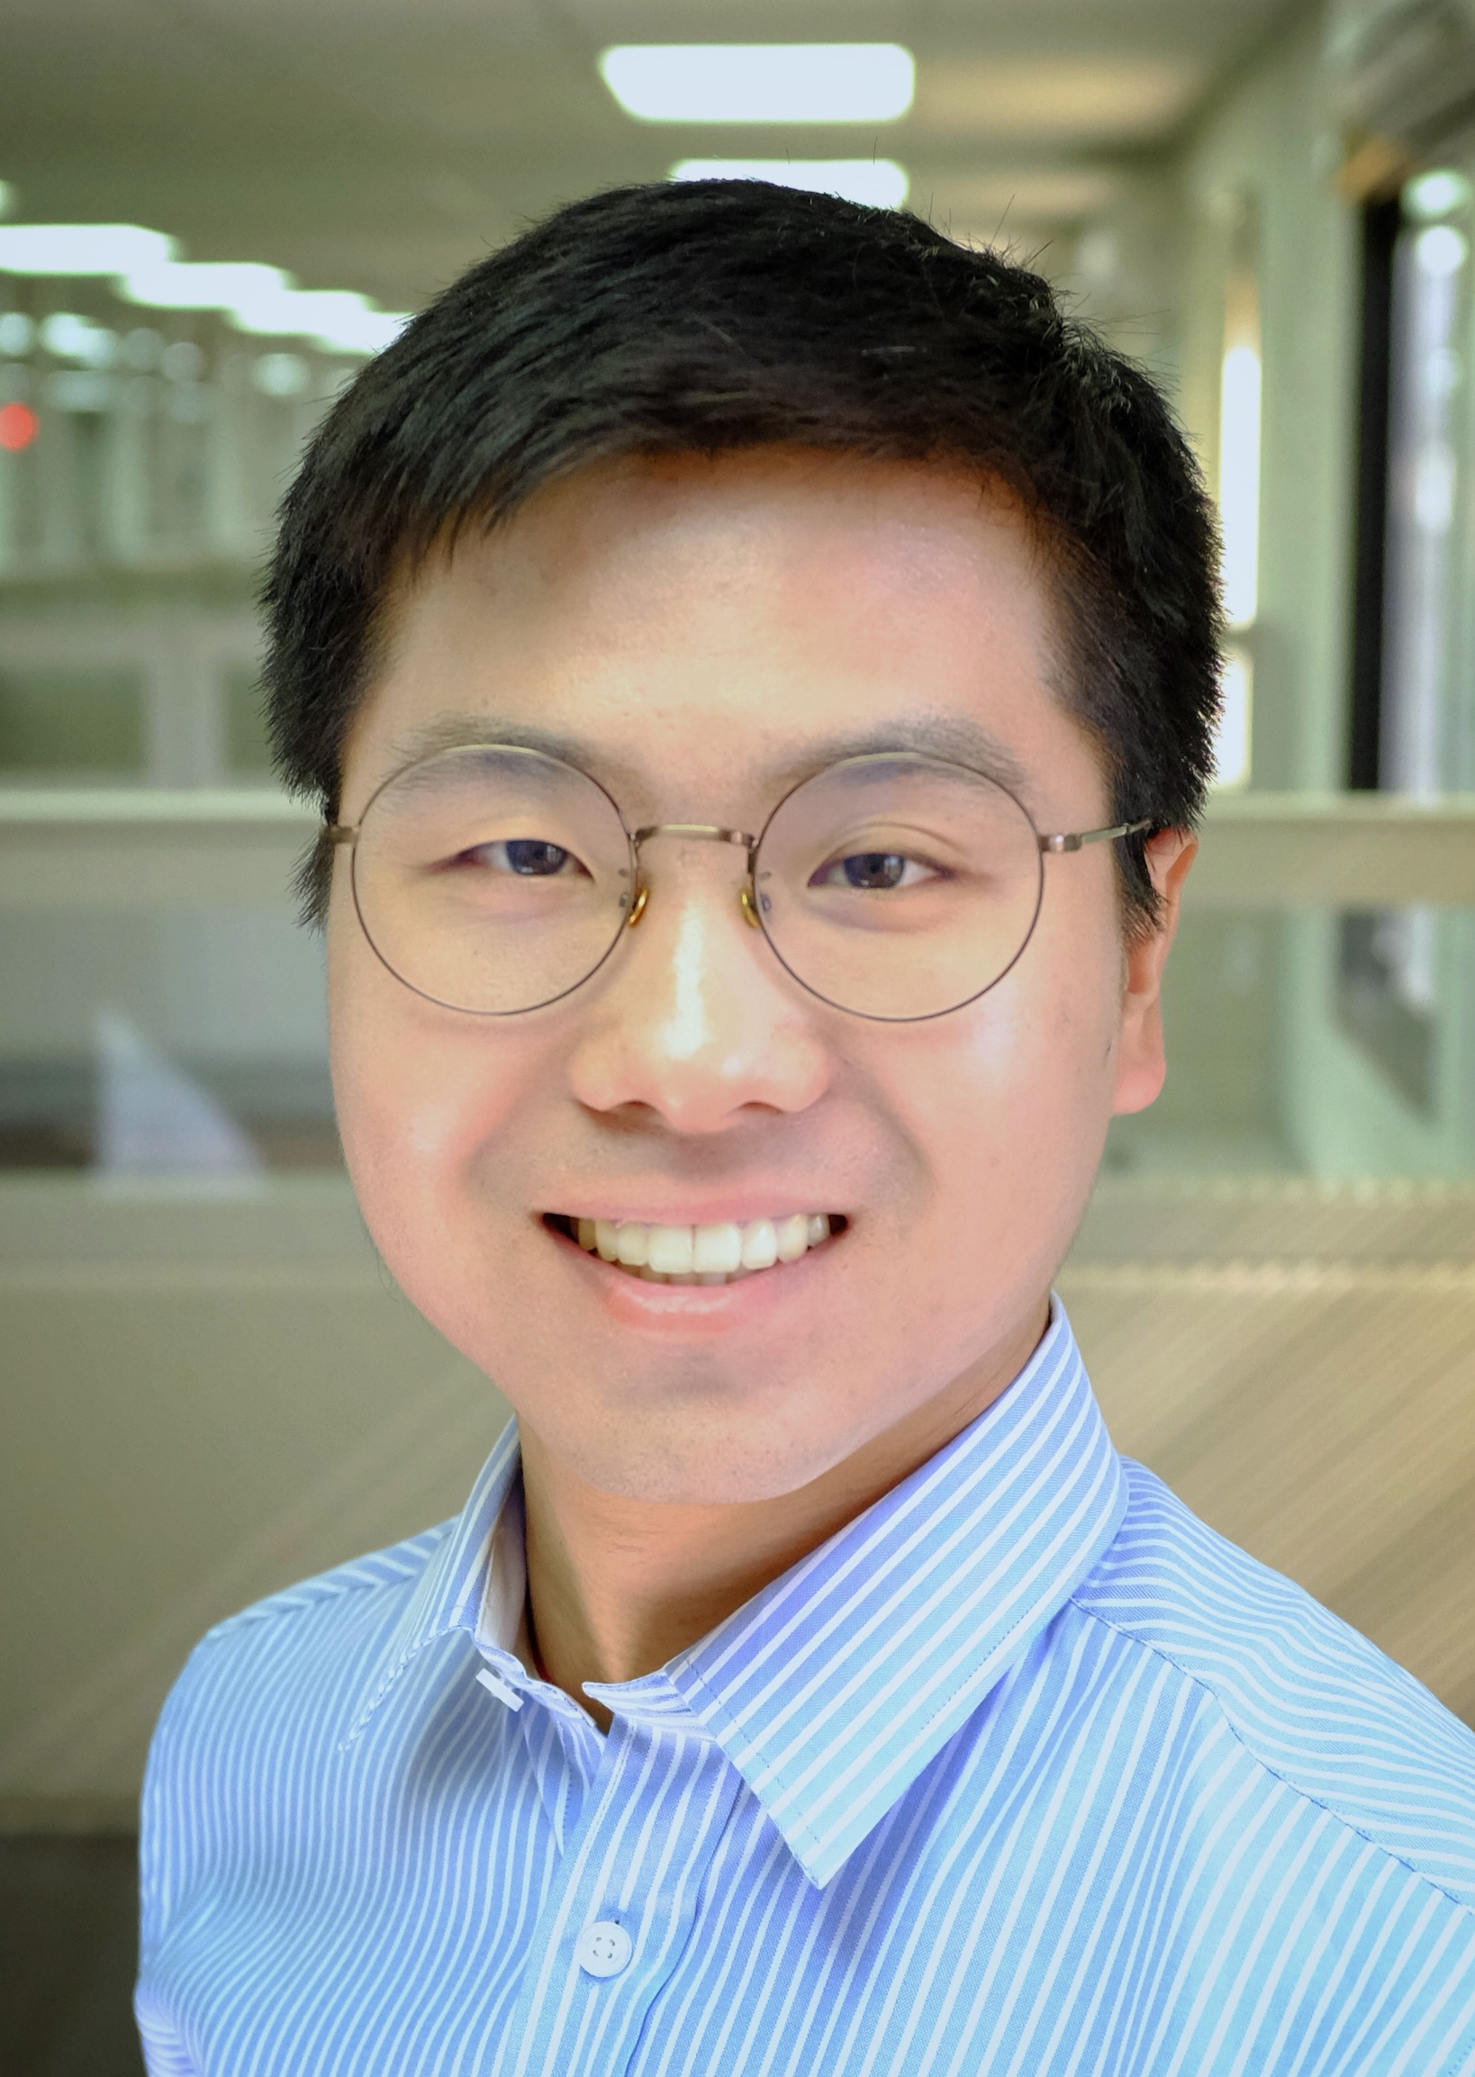
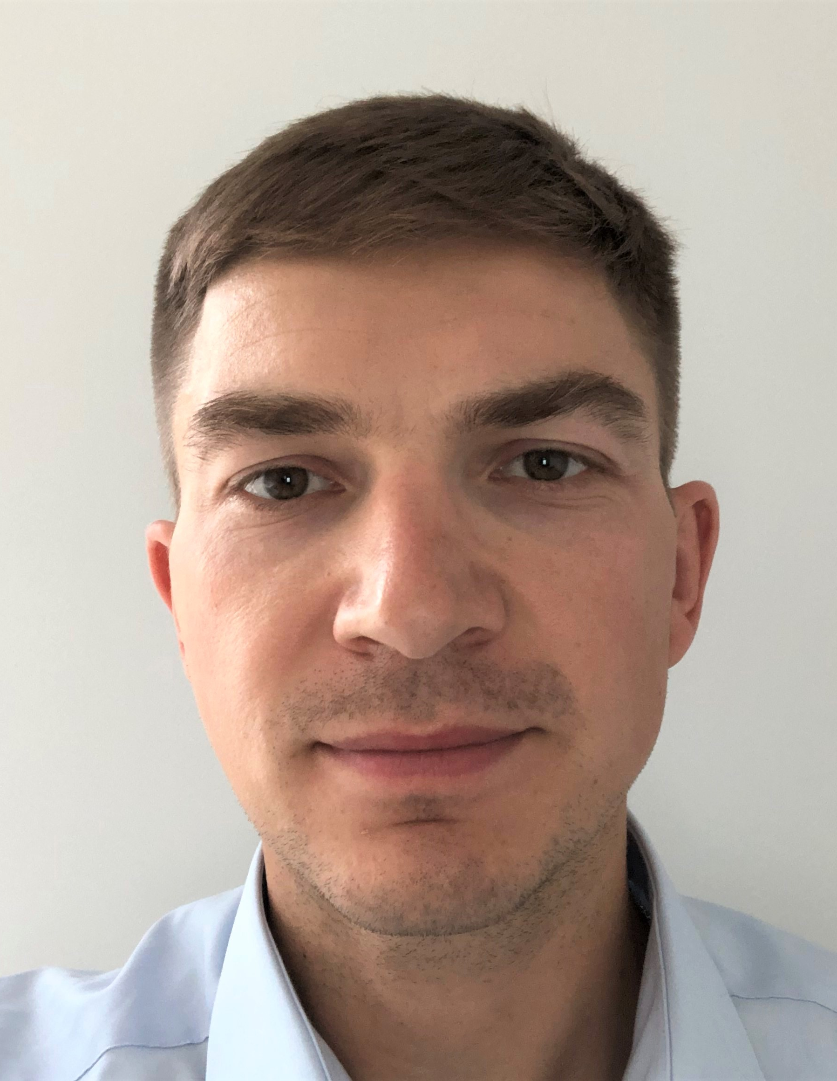
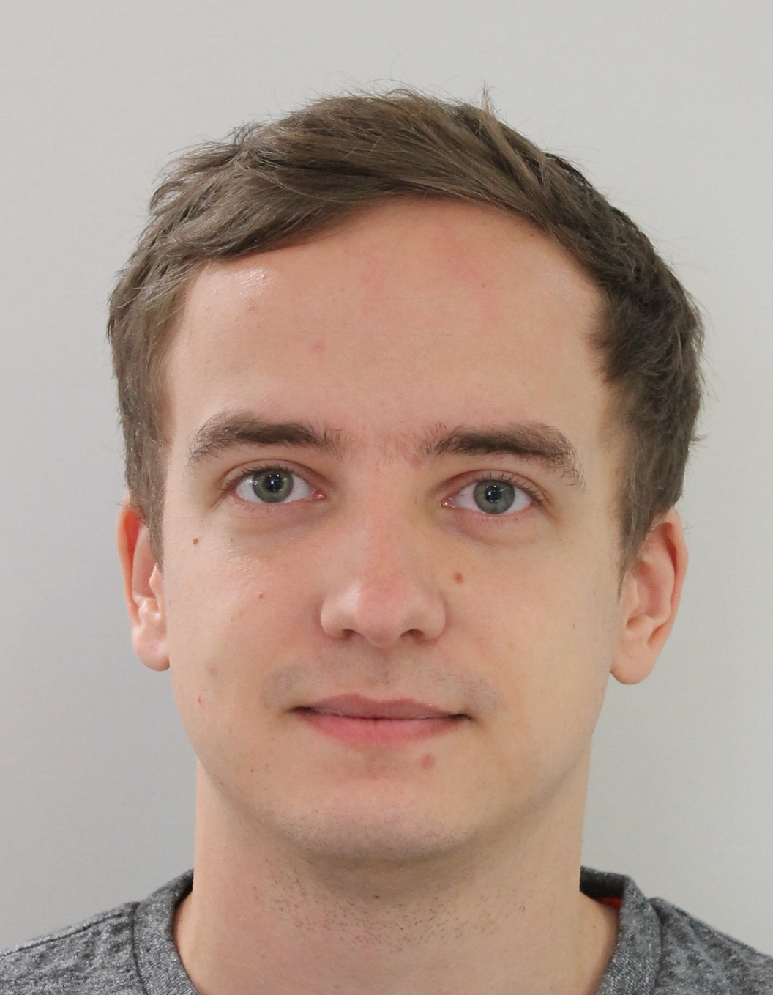
Subject Matter Experts
Bodong Li, EXPEC Advance Research Center Saudi Aramco
Email: bodong.li.1@aramco.com
Pavel Golikov Aramco Moscow Global Research Center
Email: pavel.golikov@aramcoinnovations.com Phone: +7 906 054 2034
Anton Egorov Aramco Moscow Global Research Center
Email: anton.egorov@aramcoinnovations.com

